Slide 1


Slide 2


Slide 3



Slide 4




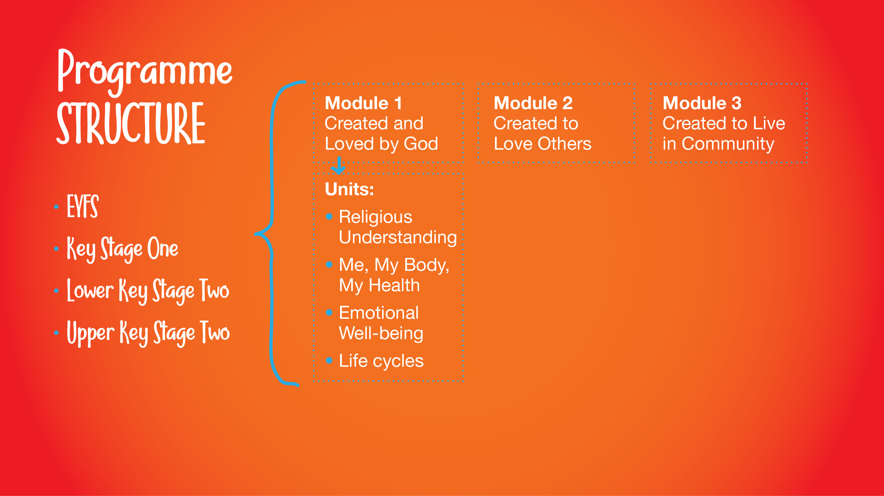
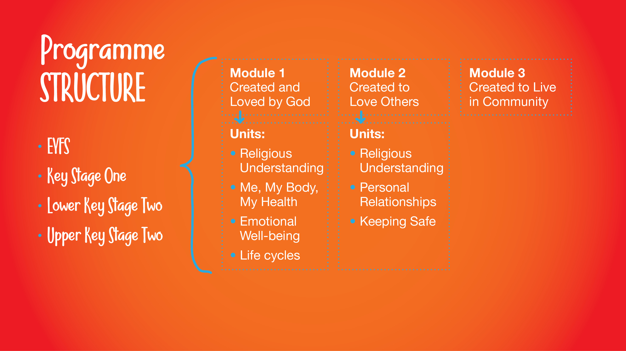
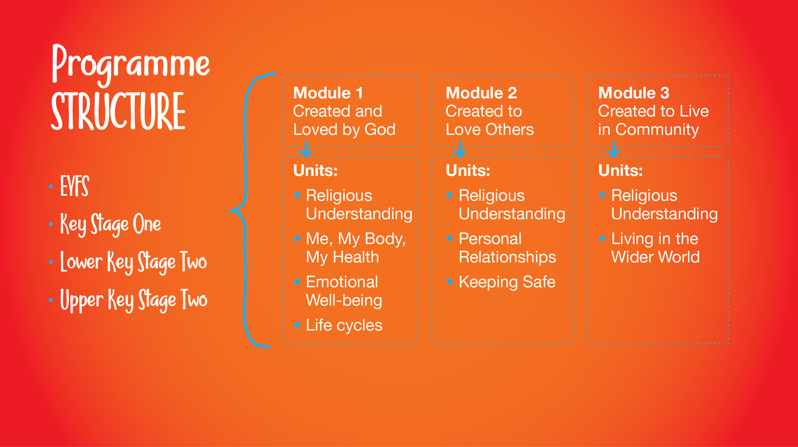
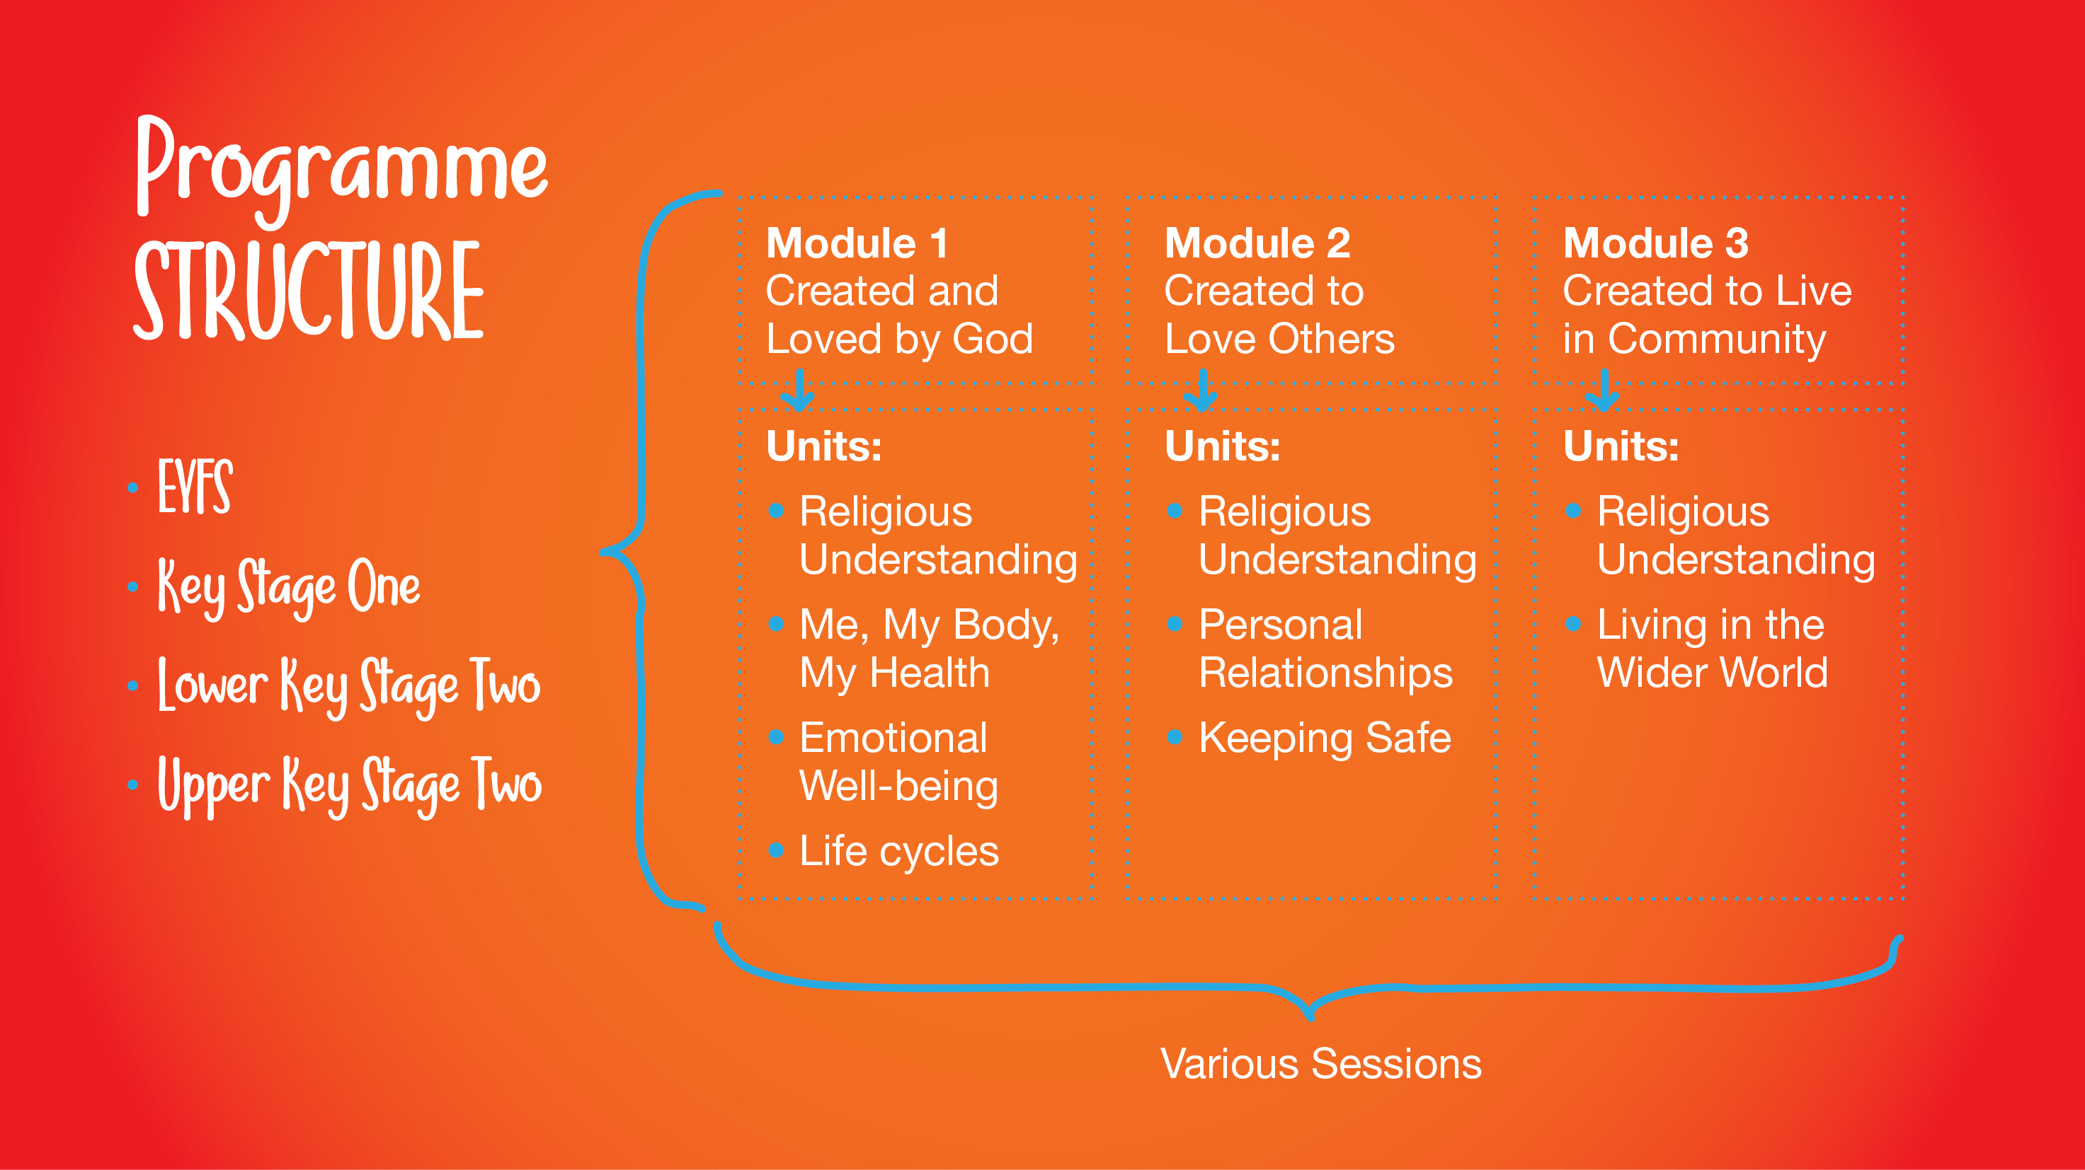

Slide 5


Slide 6


Slide 7


Slide 8


Slide 9


Slide 10
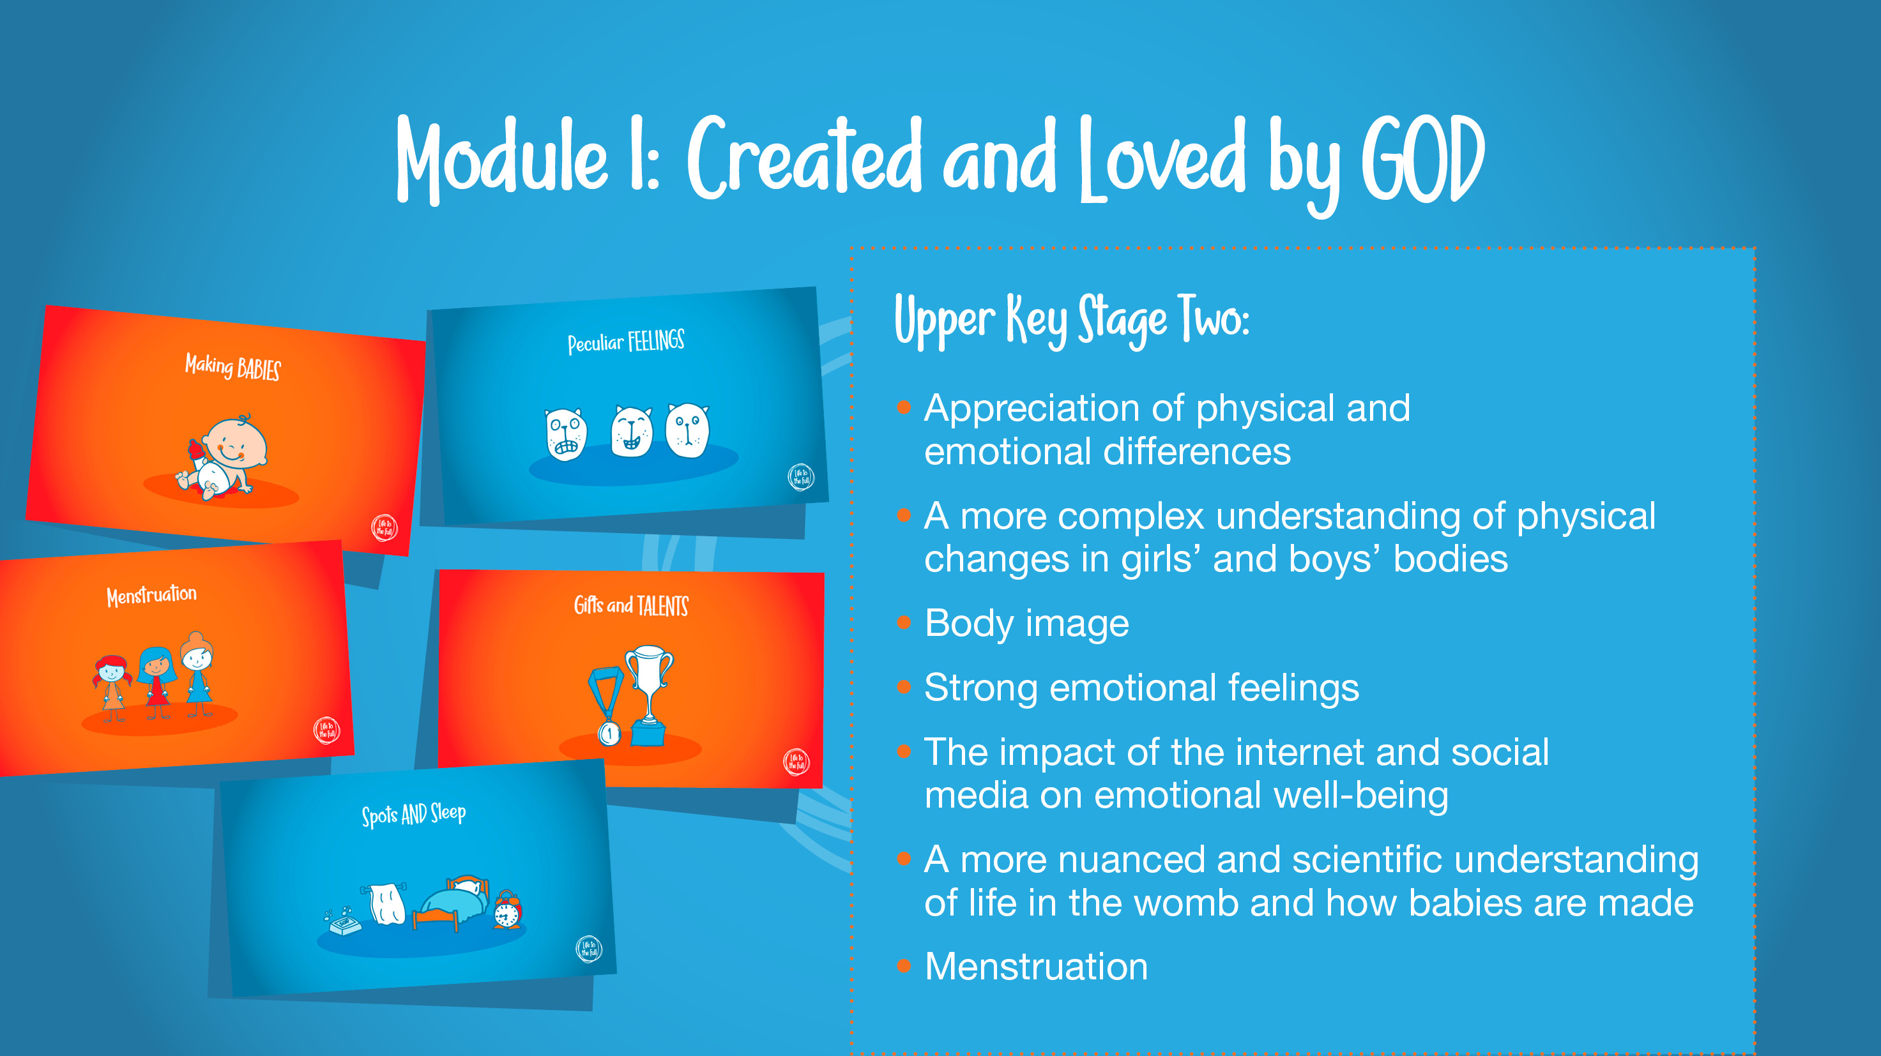

Slide 11


Slide 12


Slide 13


Slide 14


Slide 15


Slide 16


Slide 17
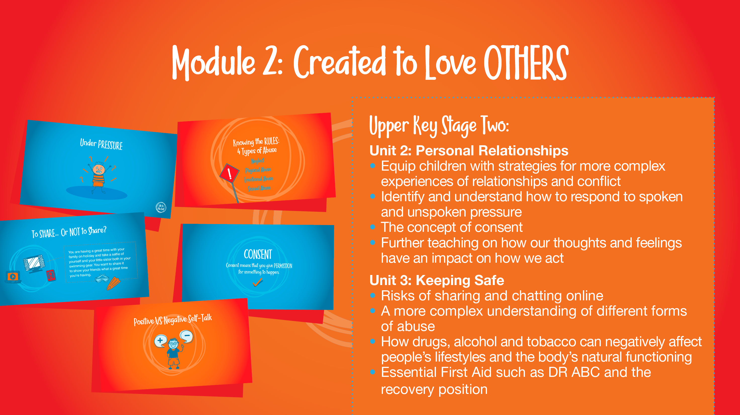

Slide 18

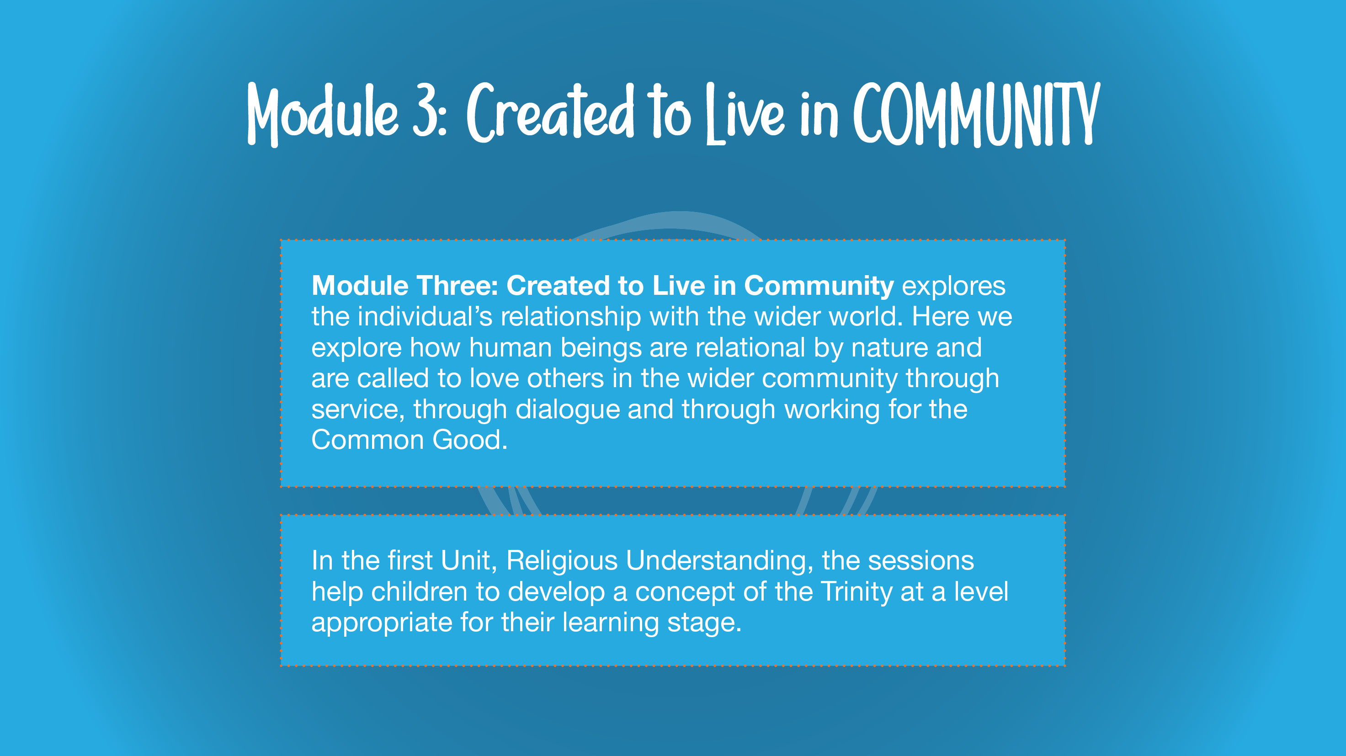

Slide 19


Slide 20


Slide 21


Slide 22


Slide 24


Slide 25


Slide 26

Similar meeting will be available each academic year
Right to withdraw
www.holytrinityacademy.co.uk/pshe
Any questions, please type them in the meeting chat on MS teams or message your child’s teacher on Class Dojo

